Slide 1

Natural Language Processing for Sentiment analysis
Cocaine Bear
By Jonathan buser

Slide 2

introduction
The goal of this project is to build a sentiment analysis model that accurately predicts the sentiment of movie reviews
Our project will show how NLP can help advertising companies better understand how people feel about products beyond just rating scores
We will explain our approach and present the results of our model

Slide 3
Data and Limitations
Data
We used IMDb data from Stanford that was pre-labeled, which consisted of 50,000 movie reviews split into 25,000 for training and 25,000 for testing.
The dataset was a suitable choice for the project because it was already pre-labeled, which saved us a significant amount of time and effort.
We applied pre-processing steps such as lemmatization and stop words removal, which helped to reduce the dimensionality of the input space and improve the accuracy of the model.
Limitations
The dataset may be biased towards a particular genre or demographic. Therefore, the model's predictions may not generalize well to other domains, such as reviews for TV shows or products.
Not up-to-date and may not be able to accurately predict the sentiment of more recent movies.
However, these limitations can be mitigated by updating the dataset regularly or using a larger and more diverse dataset that includes more recent reviews.

Slide 4

Project Overview
Preprocessing
Lemmatization, Padding, Stop Words Removal
Model
LSTM with Bidirectional Layers and Dropout Regularization
Training
Binary Cross-Entropy Loss, Optimized with Adam Optimizer
Results
Test Accuracy: 99.83%
Test AUC: Score: 0.9999

Slide 5
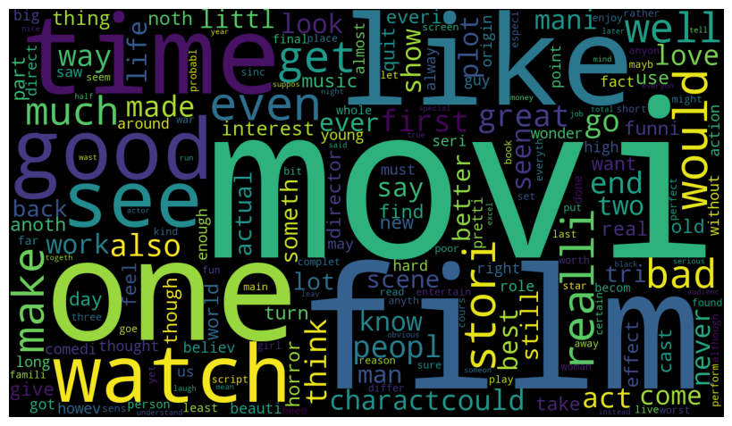
Preprocessing
Lemmatization
Reducing words to their base or root form
Padding
Uniform length of sequence to 500
Stop Words Removal
GloVe Embeddings
Removing commonly used words that don't contribute to the meaning
Pre-trained vector representations of words

Slide 6
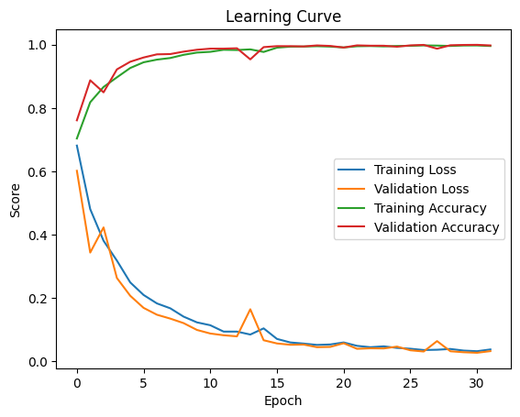
Model Architecture
Embedding Layer
10,000 Vocab Size, 500 Tokens
Bidirectional LSTM Layer
Processing input sequence in both forward and backward directions
Dropout Layer
Dense Layer (ReLU)
Dropout Layer
Dense Layer (ReLU)
Output Layer
GloVe Embedding
30% dropout rate
128 dims
20% dropout rate
6 dims
Applying the sigmoid activation function to produce the predicted sentiment score

Slide 7
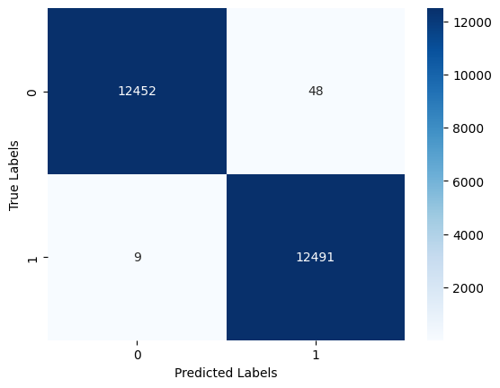
Results
Our model achieved a test accuracy of 99.77% and a test AUC score of 0.9998
Our model can accurately predict the sentiment of movie reviews
Advertising companies can use this model to better understand how people feel about movies based on the text of their reviews

Slide 8
Conclusion
Our sentiment analysis model is accurate and can help film studios better understand how people feel about movies.
By using our model, film studios can make more informed decisions about their marketing strategies and campaigns.
Using sentiment analysis to find what things people like or hate about our movie to either change our marketing strategy or our future movie releases. See App for example.

Slide 9

Thank You
Jonathan.Buser@outlook.com
https://github.com/SpaceMonkey0453/IMDB_Sentiment_Analysis

